Slide 1

IT-Solvable Problems in Economics & Business
dr Marcin Skurczyński
Introduction to Programming in Business

Slide 2
Software suport for business (Google hits)
Accountancy: 72. milion
HR: 30. milion
Management process: 662. million
Marketing: 182. million
Logistics: 37. million
OLAP: 1. milion
BPR: 0.6 milion
CRM: 27. million
Web development: 397 million
Market research: 83. million
Data mining: 97. million

Slide 3
Software categories
Data collection (i.e. marketing research tools, internet crawlers, etc.)
Data analysis (OLAP software, CRM, statistical tools, etc.)
Tools (web & software development, DBMS, direct marketing tools, accounting, etc.)
Process modelling (project management tools)
Decission suport systems

Slide 4
What problems are there to solve?

Slide 5
Simple problems
We need a webpage!
We would like to set up an online shop.
Let’s build customers database.
Can we summarize the sales for given period and given market segment?
I’d like to monitor the routes of my trucks. Can we save fuel?
How much social security will we pay in total for our employees?
We want to invest. How much will it cost?

Slide 6
Examples of problems – simulations
GM and P&G use simulation to estimate the avarage return and the riskness of new products.
GM uses simulations to forecast net income for the corporation, predicting structural costs and purchasing costs, determining its susceptibility to different kinds of risk, such as interest rate changes and exchange rate fluctuations.
Eli Lilly uses simulations to determine the optimal plant capacity that should be built for each drug.
Banking institutions use simulations to price complex financial derivatives and determine the Value at RISK of their investment portfolios.
P&G uses simulation to model and hedge foreign exchange risk
Sears uses simulation to determin how many units of each product line should be ordered from supliers
J. Curwin, R. Slater Quantitative Methods for Business Decisions

Slide 7
Examples of problems – transportation method
Allocation of machines – provides a means for allocationg machines to those factory orders best suited for each type of machine to minimize costs and to meet specific delivery dates
Allocation of fixed assets – determines the proper allocation of fixed assets, such as trucks, to those regions of the country where assets of each type operates best in terms of loading or climate conditions
Determination of freight carriers – provides management with means for determining which freight carriers feature the lowest prices for hauling the company’s finished products
R. J. Thierauf, J. J. Hoctor Smart Business Systems for the Optimized Organization

Slide 8
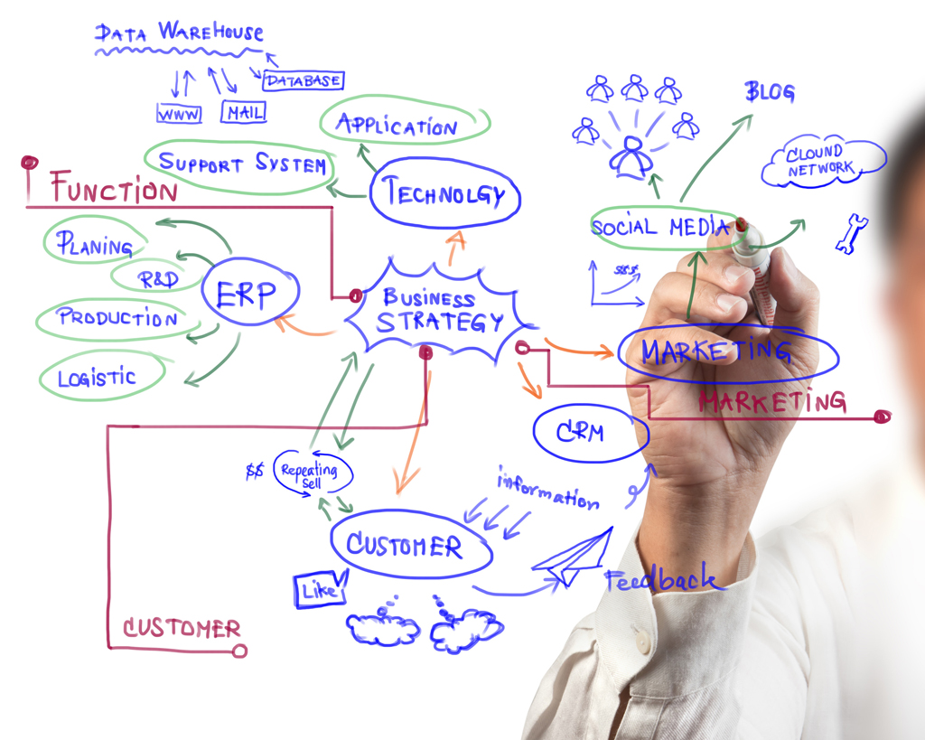

Slide 9
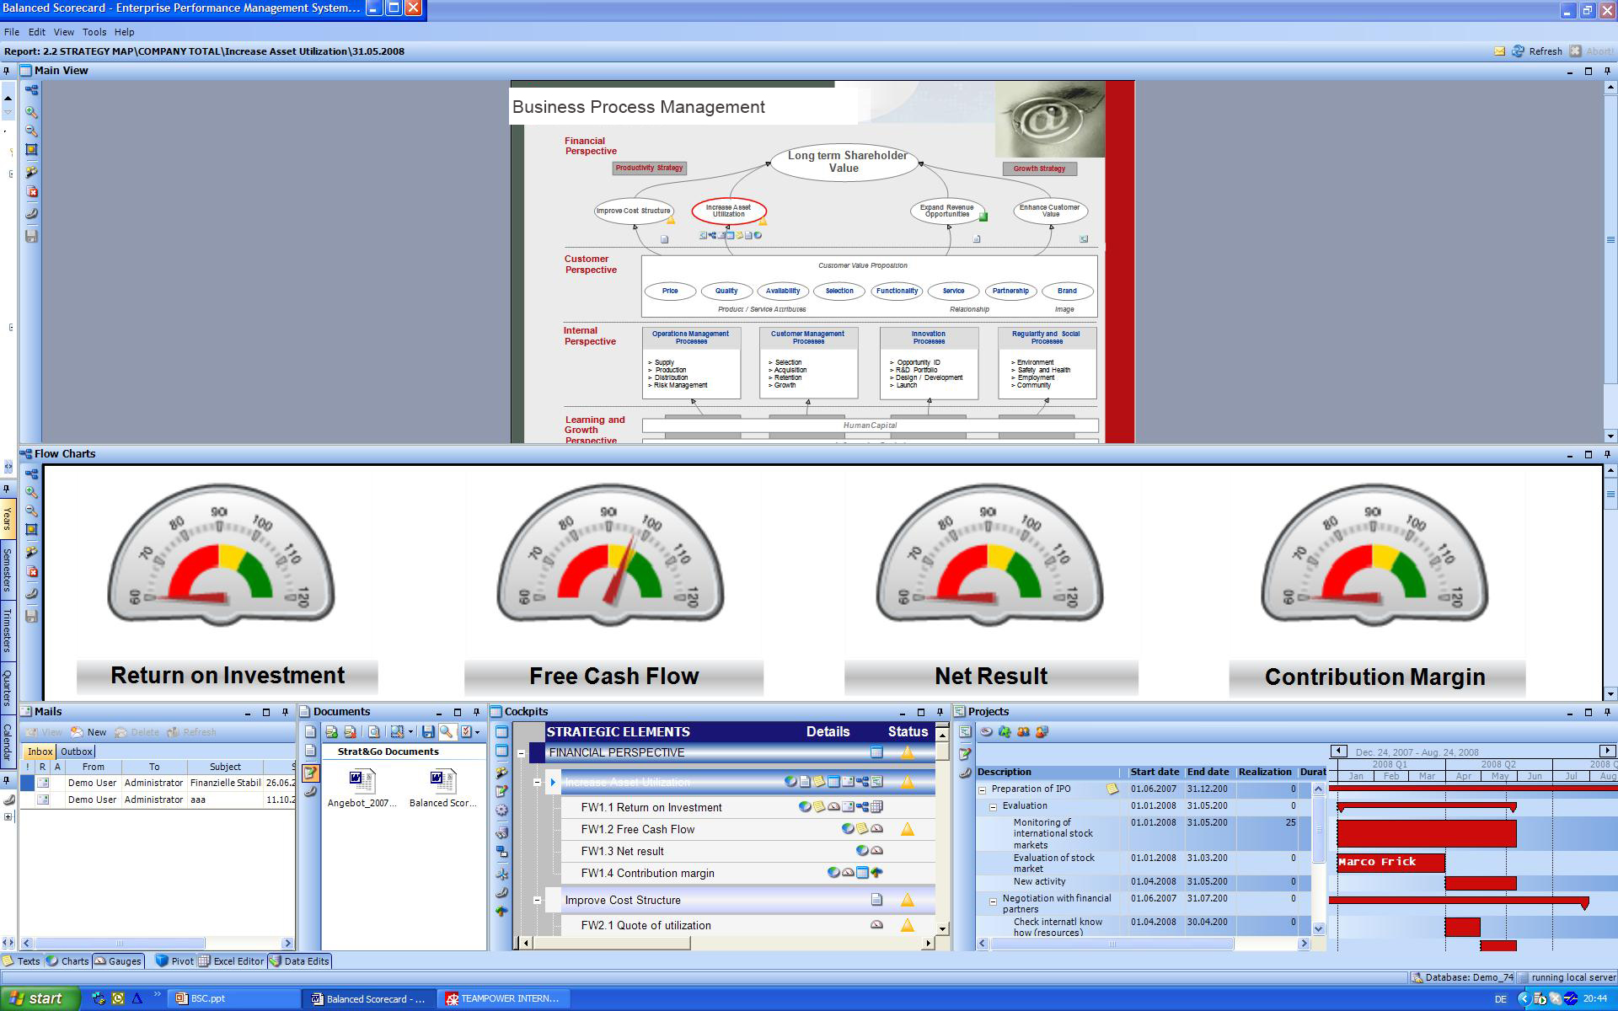

Slide 10
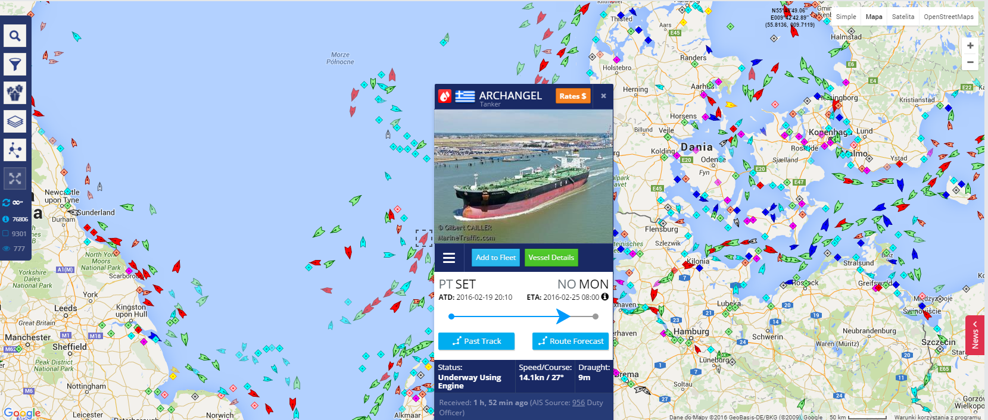
http://www.marinetraffic.com

Slide 11
Different applications
Descriptive analytics
Uncerteinty measure- ments
Statistical inference
Modelling

Slide 12












Available software?

Slide 13
In house development?
Various system platforms
Various expectations
Various use cases
Mobility
Scalability
Available technology
Skills
….

Slide 14
Framework development?
Django - Python
RoR - Ruby
Zend - PHP
Ninja - Java
Brook - Pascal
…

Slide 15
Programming languages (TIOBE Index Feb 2017)
Java
C
C++
C#
Python
PHP
JavaScript
VisualBasic .NET
Delphi / Object Pascal
Perl
Ruby
Swift
Assembly language
Go
R
Visual Basic
MATLAB
Pl/SQL
Objective-C
Scratch

Slide 16
Introduction to GitHub and Python
dr Marcin Skurczyński
Introduction to Programming in Business

Slide 17
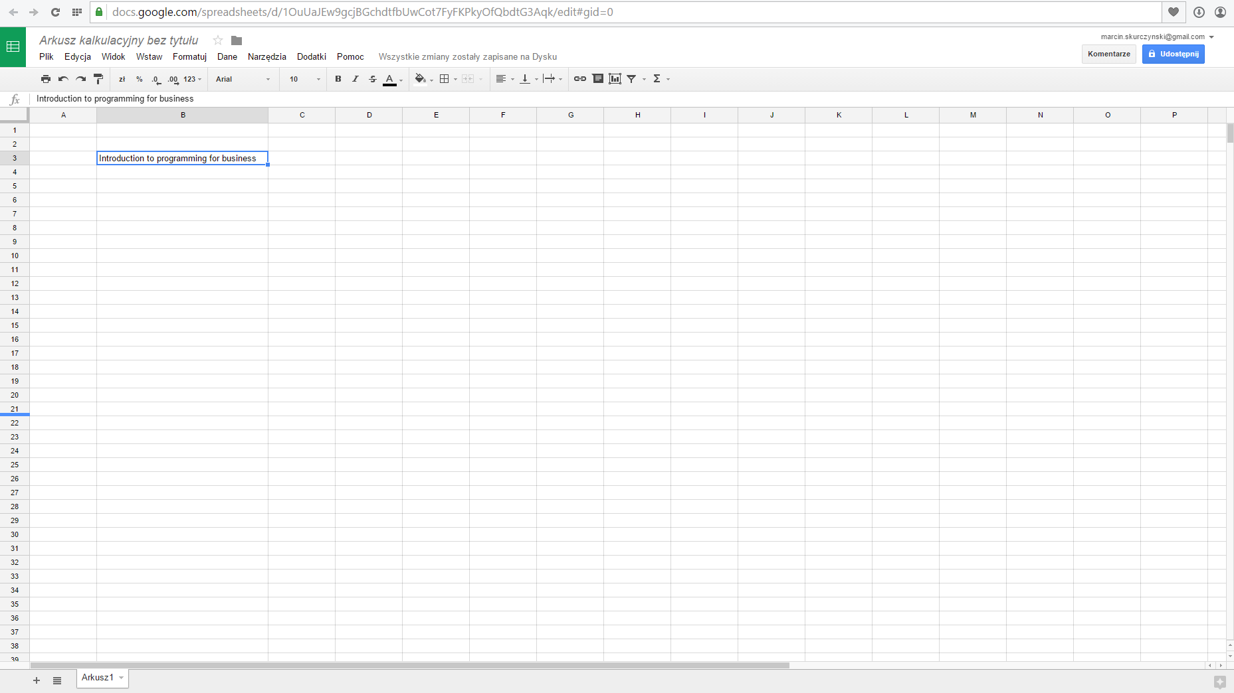
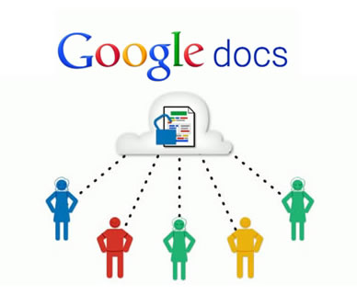
How to work on the same project in large group?

Slide 18
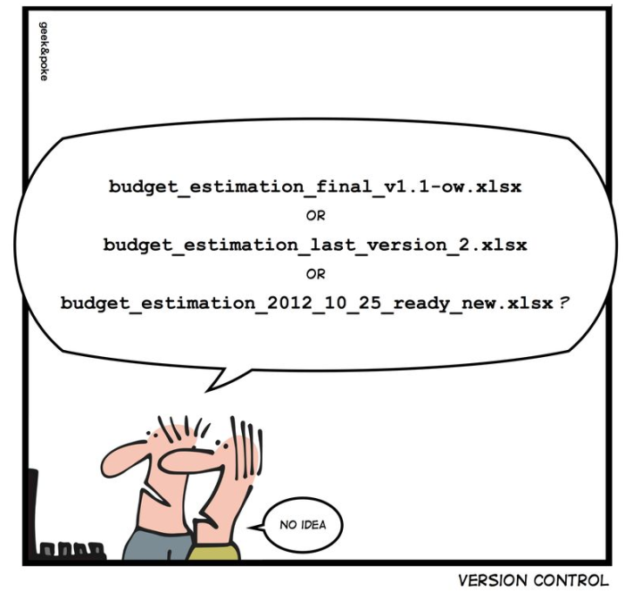
Setting the space – version control
Frequent code changes
Necessity to step back
Workgroup cooperation
Version Control Systems:
Client-server model:
Subversion (SVN)
IBM Rational ClearCase
Distributed model:
Git
Mercurial
Code Co-op

Slide 19








Version control?

Slide 20
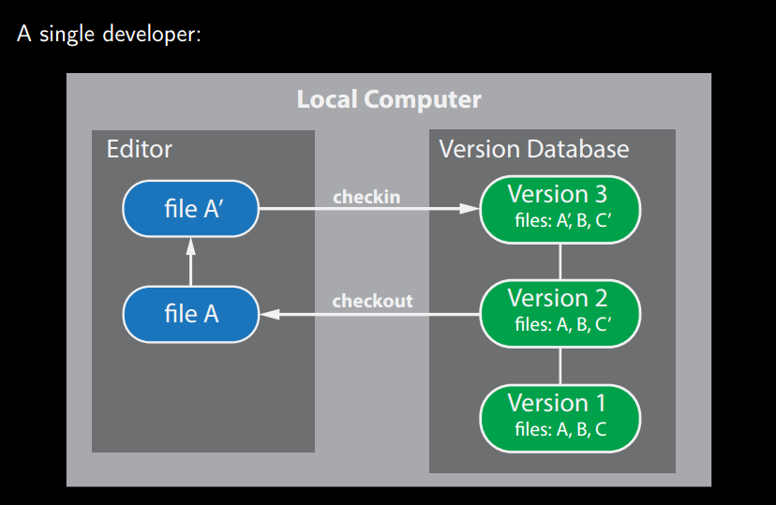
Local version control

Slide 21
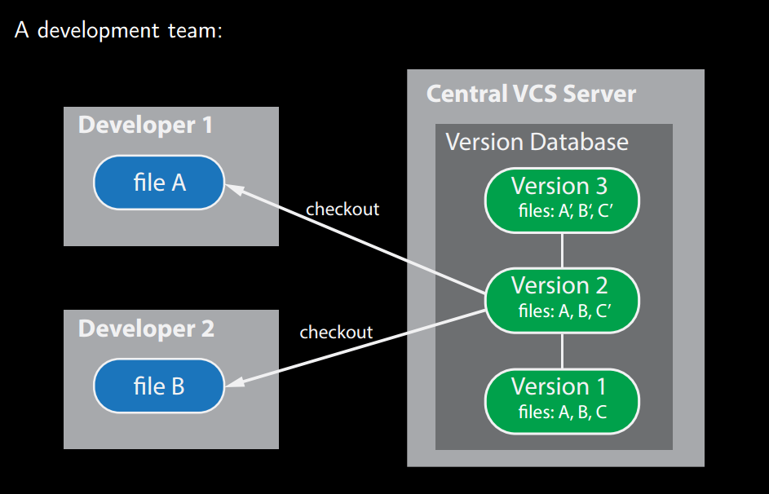
Centralized version control

Slide 22
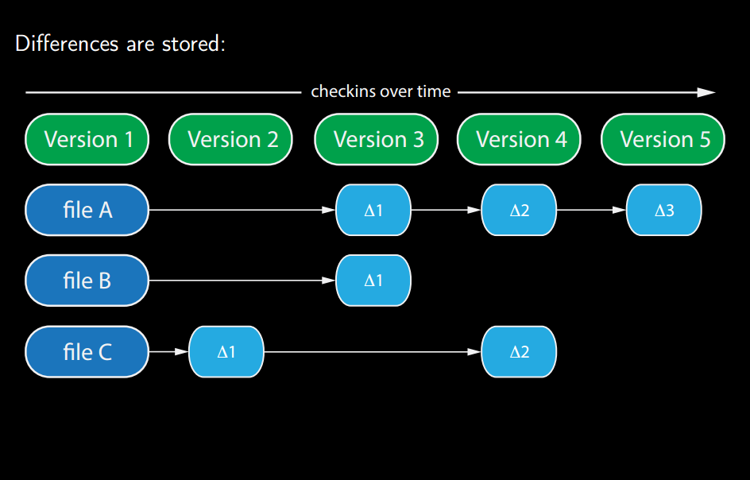
Centralized version control

Slide 23
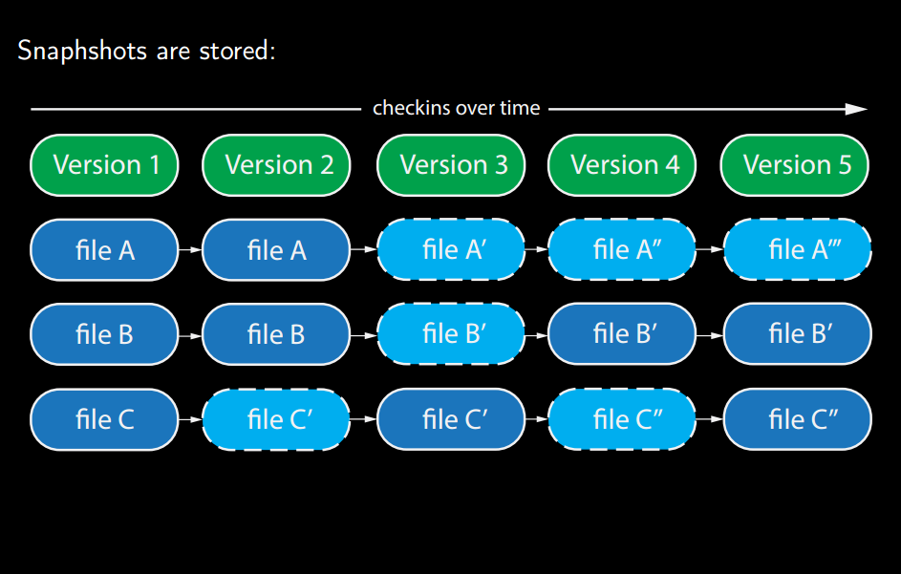
Distributed version control

Slide 24
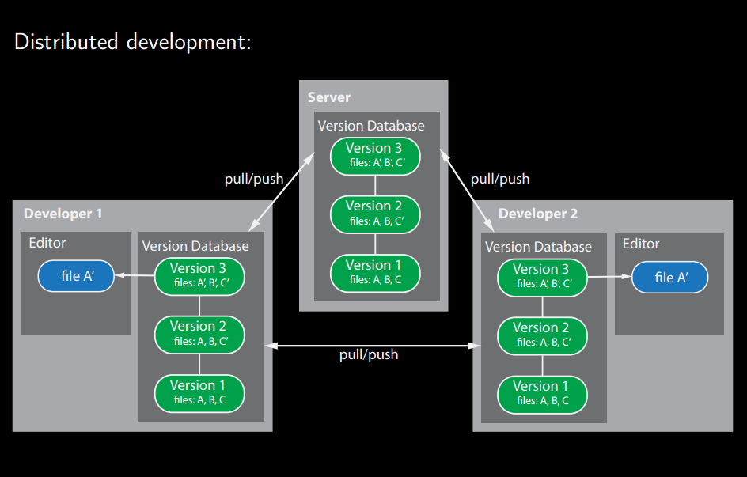
Distributed version control

Slide 25
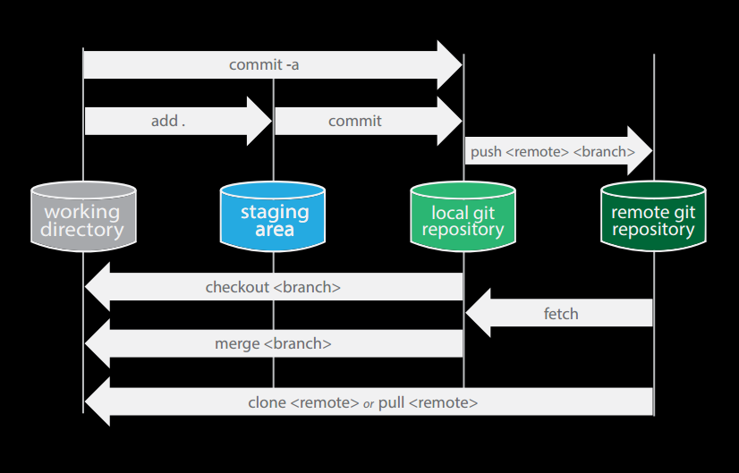
How GitHub works?

Slide 26
Task 0: Set-up your GitHub account
Visit www.github.com
Set-up an account
Clone IPB2016 repository from the user: marcin-skurczynski

Slide 27
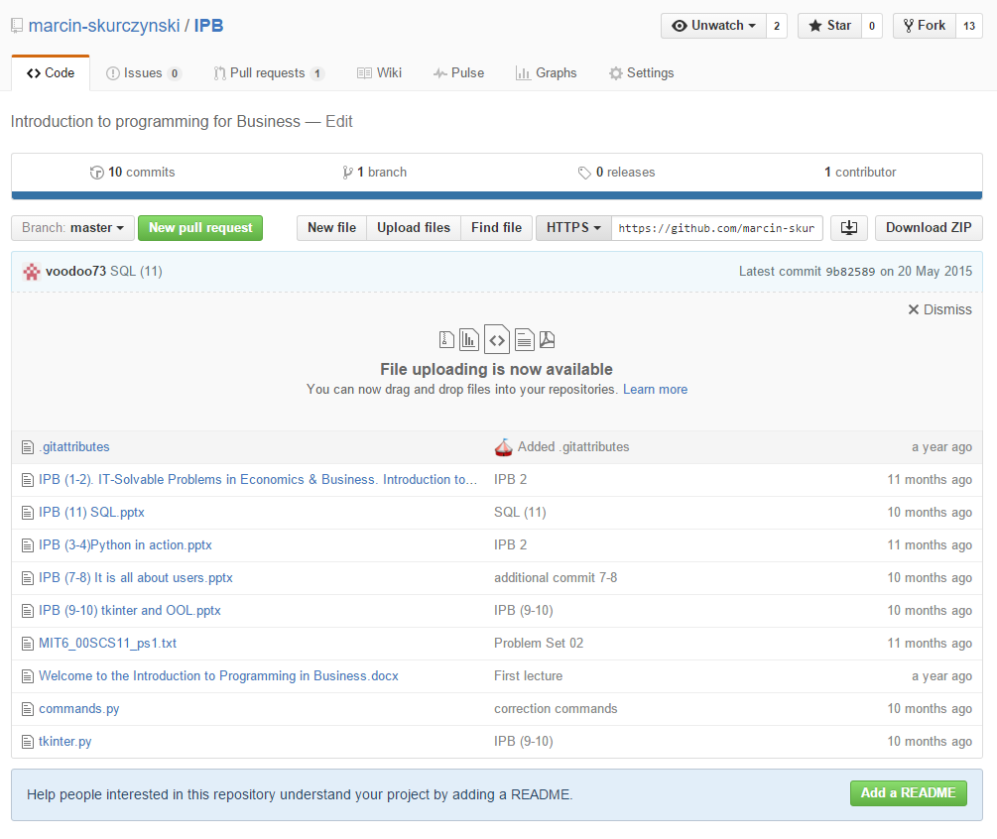

Slide 28
Python programming language
General-purpose, high-level programming language
Conceived in the late 1980s
Scripting language
Many libraries, frameworks and additional resources
See: python.org
Where did the name come from?

Slide 29


Slide 30
Python philosophy
Beautiful is better than ugly
Explicit is better than implicit
Simple is better than complex
Complex is better than complicated
Readability counts

Slide 31
Python environment: IDLE
Current version: 3.5.1
The most described version: 2.7
On-line Python console: repl.it

Slide 32
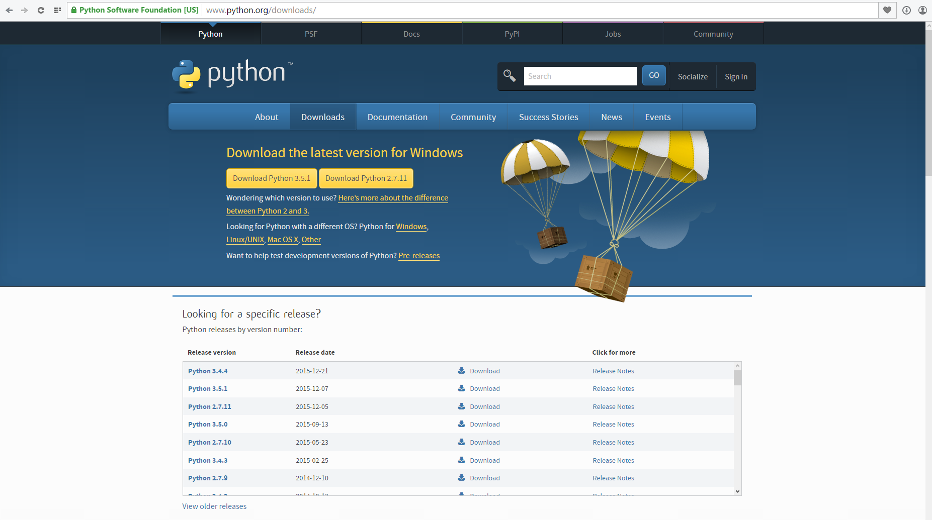

Slide 33
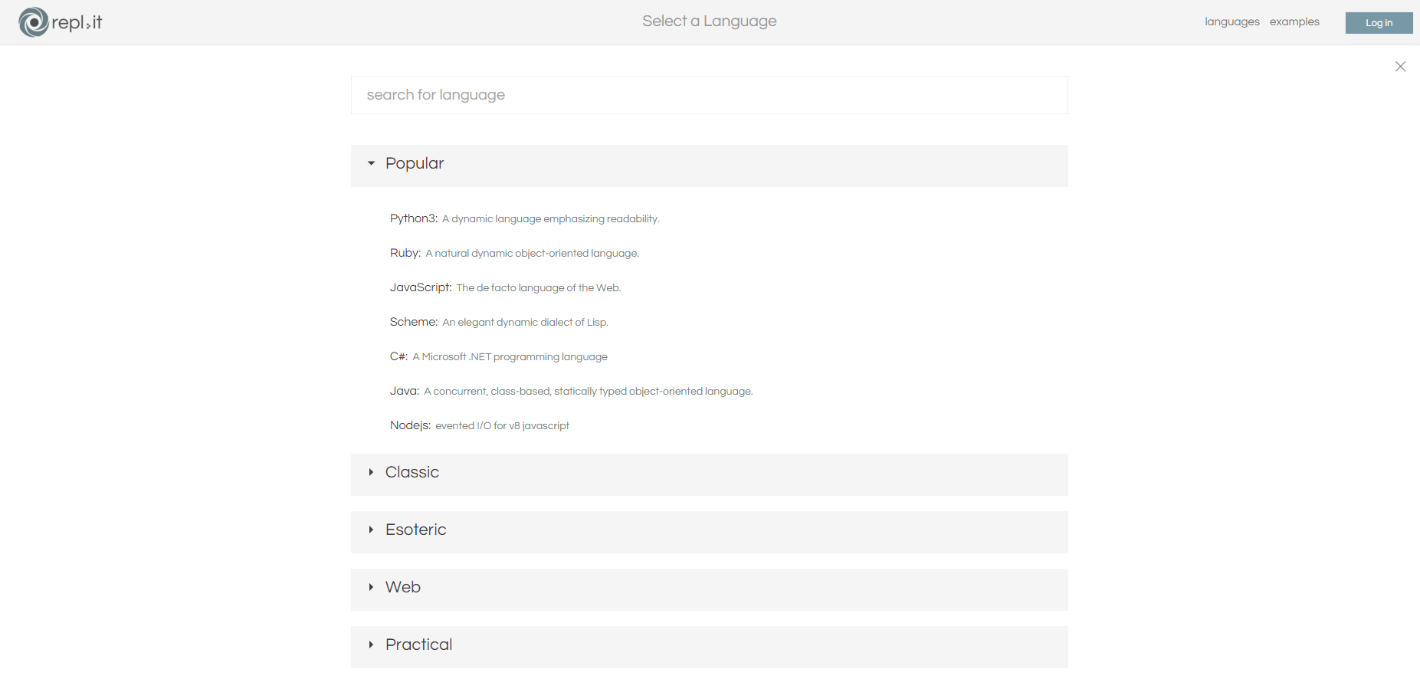

Slide 34
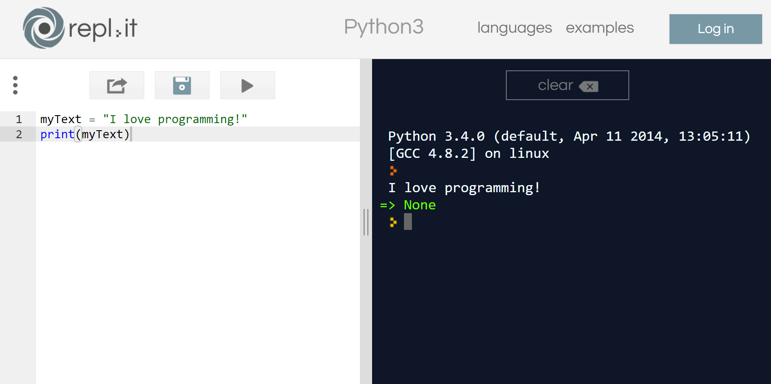

Slide 35
Python: example code
dob = input('Please enter your date of birth: ')
last_name = input('Please enter your last name: ')
print (last_name)
print (dob)

Slide 36
What happens in ATM?
Insert a card
….
….
….
X. Print receipt

